Slide 1
AN INTRODUCTION TO AGE AND LENGTH STRUCTURED STOCK ASSESSMENT MODELS
(SEQUENTIAL POPULATION ANALYSES)
“How Did You Guys Come Up With Those Numbers, Anyway?” Pierce and Hughes, 1979
Joseph T. DeAlteris
University of Rhode Island
Kingston, RI

Slide 2
Presentation Outline
Statement of Purpose
S.P.A. Inputs and Outputs
Development of Age and Length Structured Retrospective and Projection Models
Projection Models
Retrospective Models
Applications and Limitations of A.C.A. and L.C.A.
Summary and Conclusions

Slide 3
Purpose of this Presentation
To provide a qualitative and quantitative understanding of the principles and limitations of age and length structured models used in fish stock assessment and fisheries management.

Slide 4
Sequential Population Analysis Models: Inputs and Outputs
Utilize catch data by age or length class, an assumed natural mortality, and sometimes survey data.
Provide retrospective estimates of fishing mortality rates and absolute population abundance for past and present stock.
Provide the basis for projection of future stock abundance and potential catches.

Slide 5
Development of Projection Models
Thompson and Bell (1934) – applied growth and mortality equations to predict stock yield for the Pacific halibut fishery.
Beverton and Holt (1957) – yield per recruit models.
Ricker (1975) – general fisheries stock analyses
And others.

Slide 6
Development of Retrospective
Age-Structured Models
Baranov (1918) – summed catch from a cohort to estimate initial cohort abundance.
Fry (1957) – referred to the stock estimate as a “virtual population.”
Beverton and Holt (1957) – included natural mortality.
Gulland (1965) – added the catch equation.
Pope (1972) – introduced “cohort analysis,” a simplification of VPA.
Megrey (1989) – review and comparison of SPA methods.

Slide 7
Development of Retrospective
Length-Structured Models
DeLury (1947) – on the estimation of biological population.
Jones (1974) – modification of Popes (1972) age-based cohort analysis.
Collie and Sissenwine (1983) – estimating population size from relative abundance data measured with error.
Conser and Idoine (1992) – NMFS-NEFSC modified DeLury.
Cadrin and Estrella (1996) – length-cohort analysis for American lobster.

Slide 8
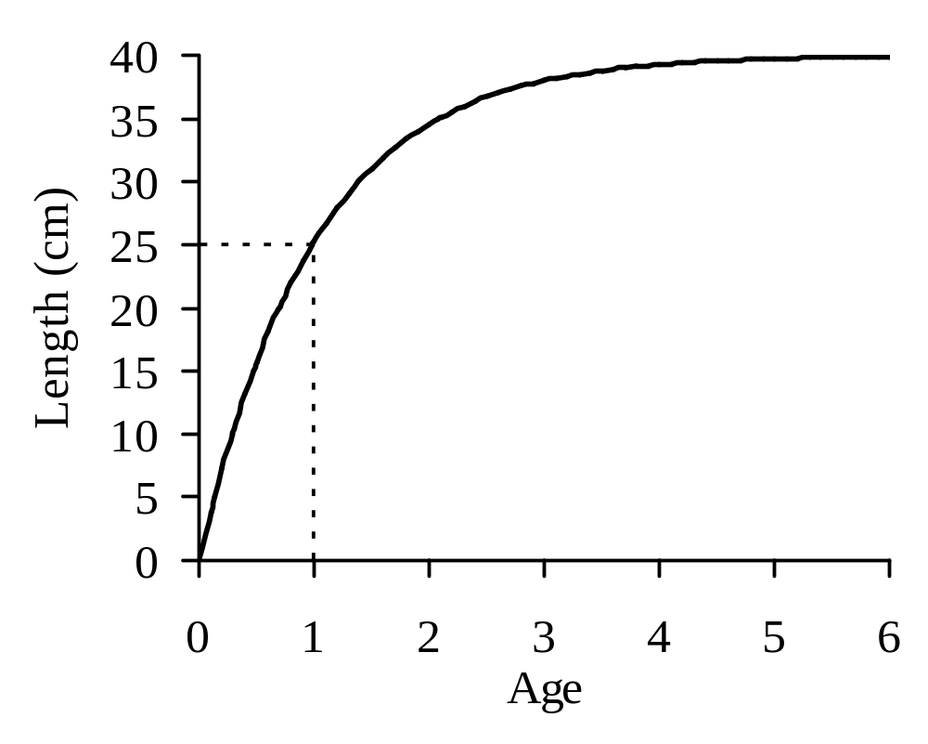
Fresh Water Pond Fish
Growth Characteristics
L∞ = 40 cm
K = 1.0
t_{c} = age 1
L_{c} = 25 cm
Recruit to Fishery

Slide 9
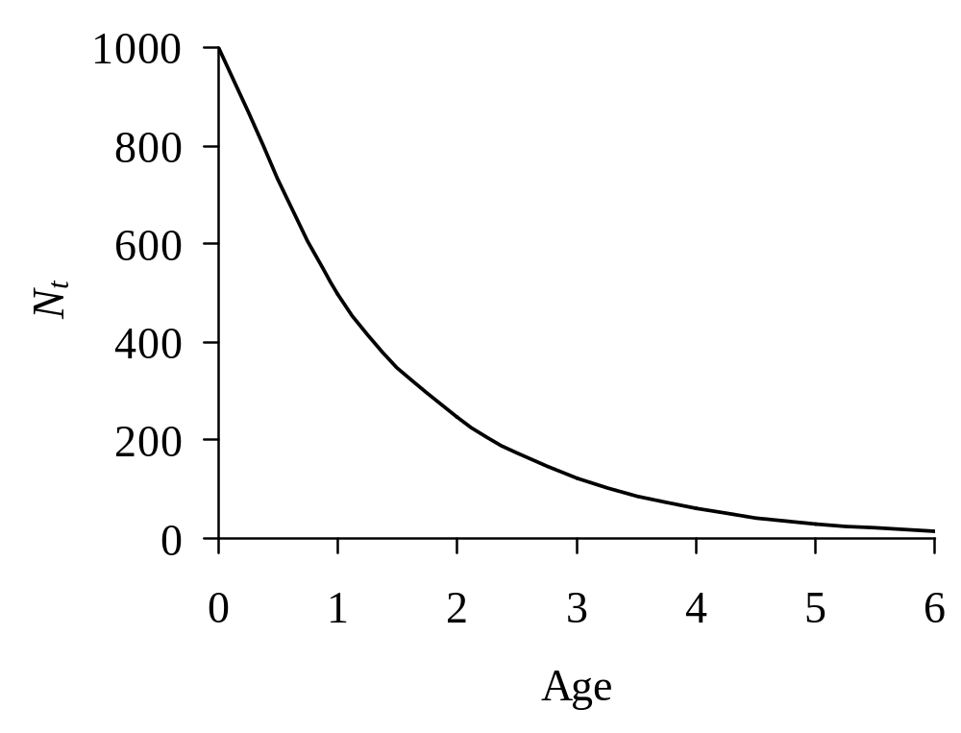
Fresh Water Pond Fish
Natural Mortality Characteristics
M = 0.7
Life Span = 5 years

Slide 10
Projection Model
Predicts the future cohort abundance and catch based on past cohort size and specified levels of fishing and natural mortality.

Slide 11
Age-Based Projection Model
The survival equation, an exponential decay model is:
Where N₀ is the cohort abundance at age 0
N_{t-1} is the cohort abundance at age t-1 year
N_{t} is the cohort abundance at age t
F_{t} is the fishing mortality for age t
M is the natural mortality
Z_{t} is the total mortality for the age t

Slide 12
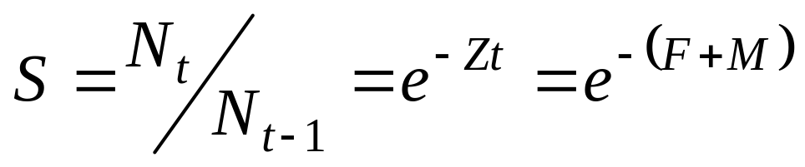
Age-Based Projection Model
Survival is the proportion of a cohort remaining at each age:

Slide 13
Example: Age-Based Projection Model
Problem:
Consider a pond stocked with 500 age 1 fish, and that during subsequent years, 75% are lost equally to fishing and natural each year. Project trajectories of catch and cohort number remaining for years 2 to 6.
Solution:
Therefore, 25% survive or 125 fish become age 2 and 75% are lost or 375 fish die, 188 due to natural causes and 188 due to fishing
And so on

Slide 14
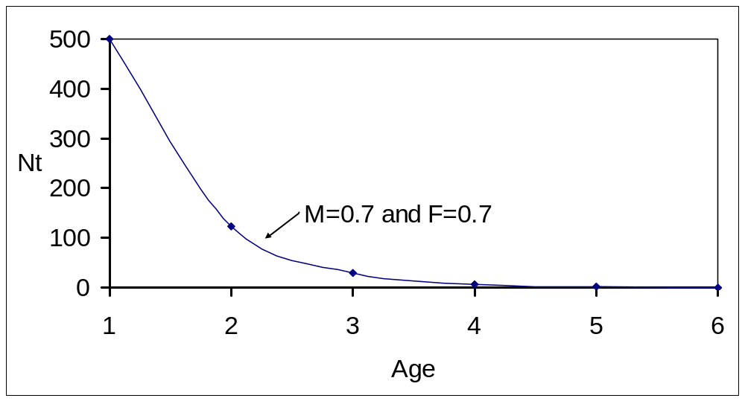
Projection of a Pond Fish Cohort or Year-Class (age-based) with
Fishing and Natural Mortality

Slide 15
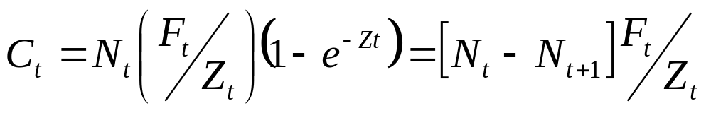
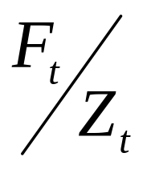
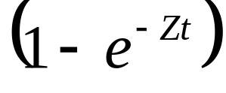
Age-Based Projection Model
Baranov Catch Equation is:
Where C_{t} is the catch at the age t
is the proportion dying due to the fishery for the tth age
is the mortality rate for the tth age.

Slide 16
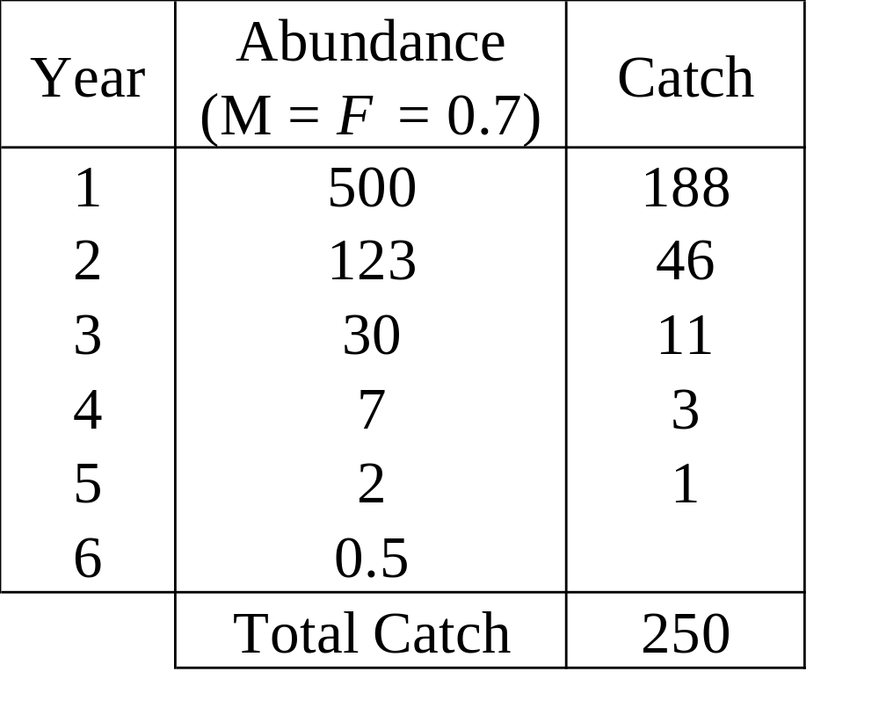
Age-Based Projection of
Cohort Abundance and Catch

Slide 17
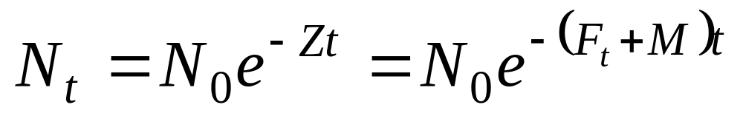
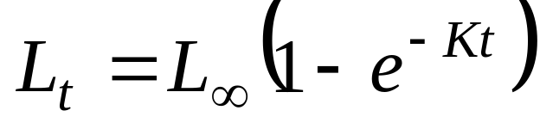
Length-Based Projection Model
The exponential decay equation:
is combined with the simplified von Bertalanffy growth equation:
where L_{t} is the length at age t
L∞ is the maximum length
K is the growth coefficient.

Slide 18
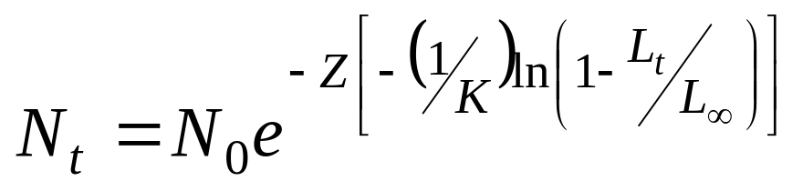
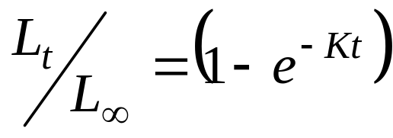
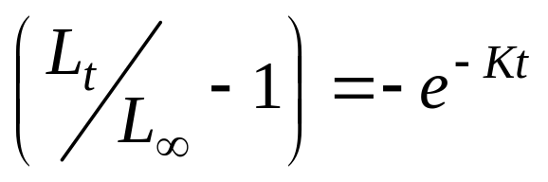
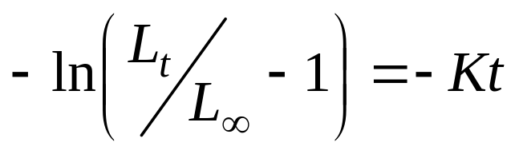
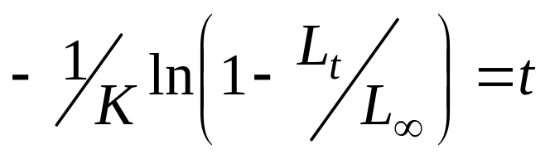
Length-Based Projection Model
The result is:
because the simplified von Bertalanffy equation can be rearranged and solved for t:

Slide 19
Example: Length-Based Projection Model
Problem:
(A) Recall the growth and natural mortality characteristics of the pond fish. Determine the number of fish remaining from a single cohort as a function of length, starting with 1000 age 0 recruits.
(B) Now consider the effect of adding an equal amount of fishing mortality to natural mortality (0.7) on all fish larger than 25 cm or age 1. Project the trajectory of cohort number and catch as a function of length for lengths from 25 to 40 cm.

Slide 20
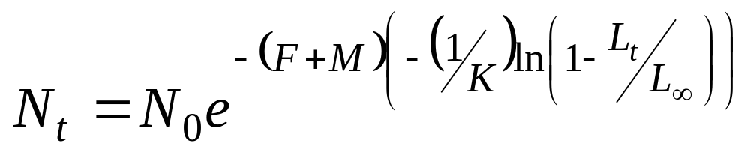
Example: Length-Based Projection Model (continued)
Solution:
Where L_{t} is 0, 5, 10, 15, 20, 25, 30, 35, and 40 cm
L∞ = 40 cm
M = 0.7
F = 0.0 for L_{t} 0 - 24 cm
0.7 for L_{t} 25 - 40 cm

Slide 21
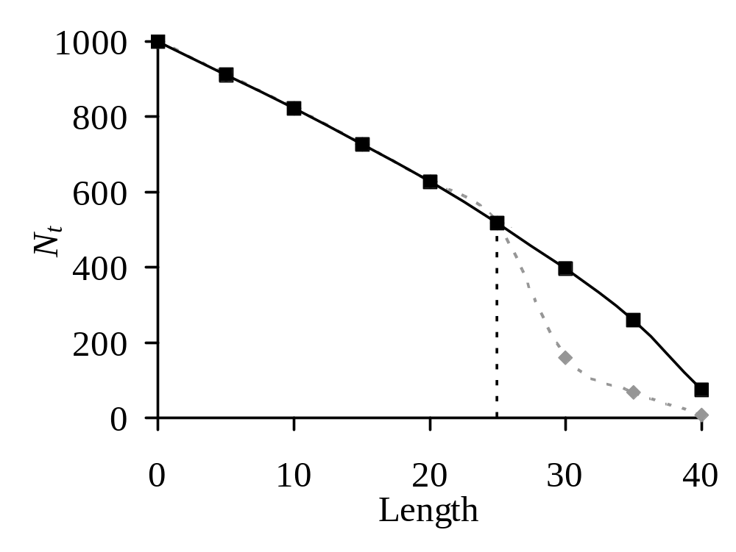
Projection of a Pond Fish Cohort (length-based) with Natural and Fishing Mortality

Slide 22
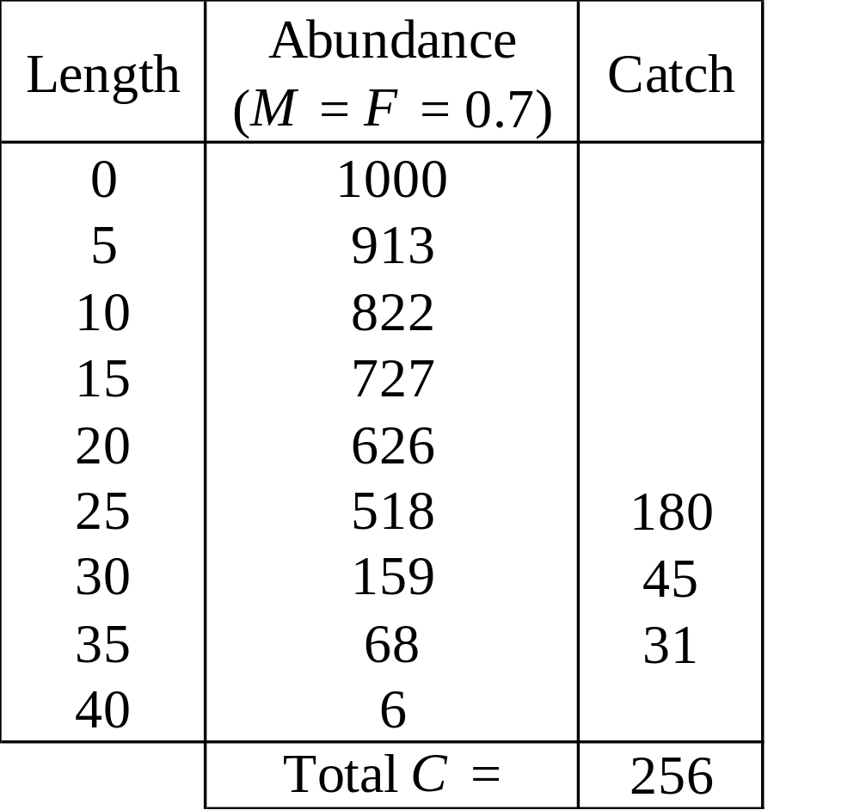
Length-Based Projection Model of Cohort Abundance and Catch

Slide 23
Retrospective Models
Age-based: Virtual Population Analysis (V.P.A.) Cohort Analysis (A.C.A.)
Length-based: Cohort Analysis (L.C.A.)

Slide 24
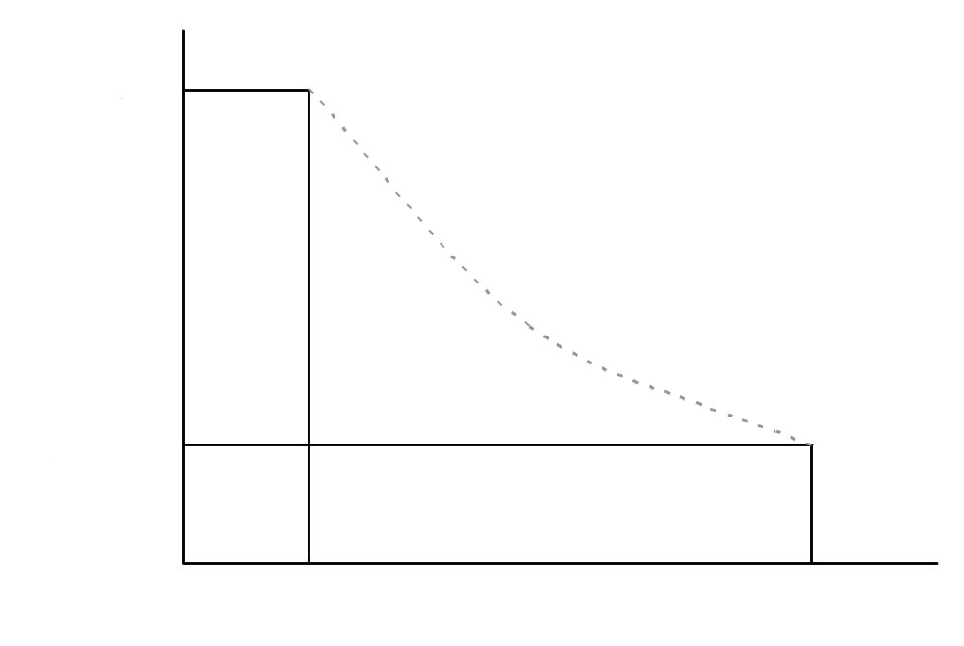
Virtual Population Analysis (Age-based)
Catch and
Natural Mortality

Slide 25
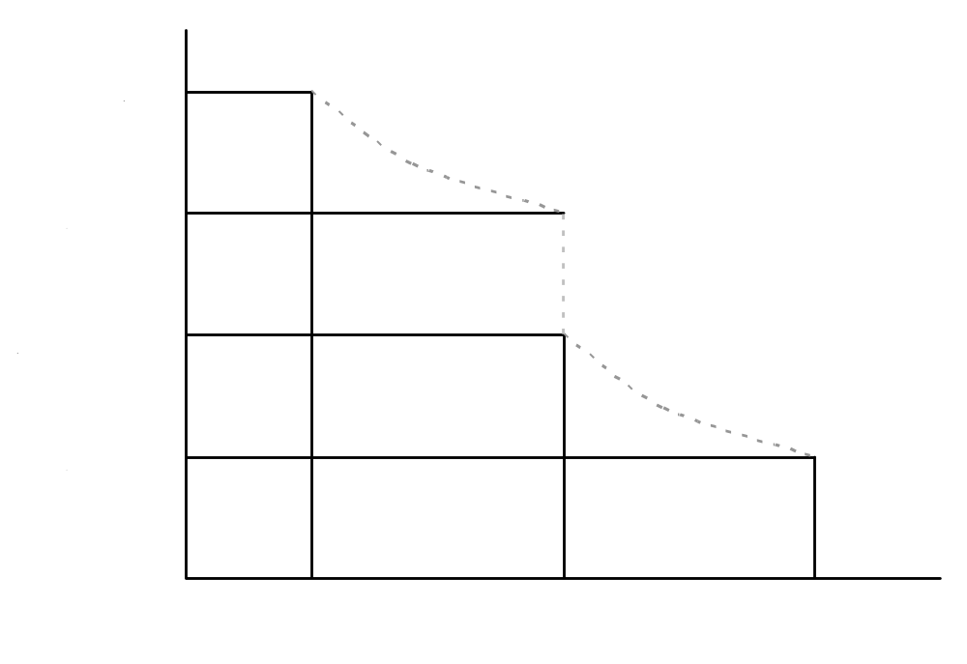
Cohort Analysis (Age-based)
Natural Mortality
Catch
Natural Mortality

Slide 26
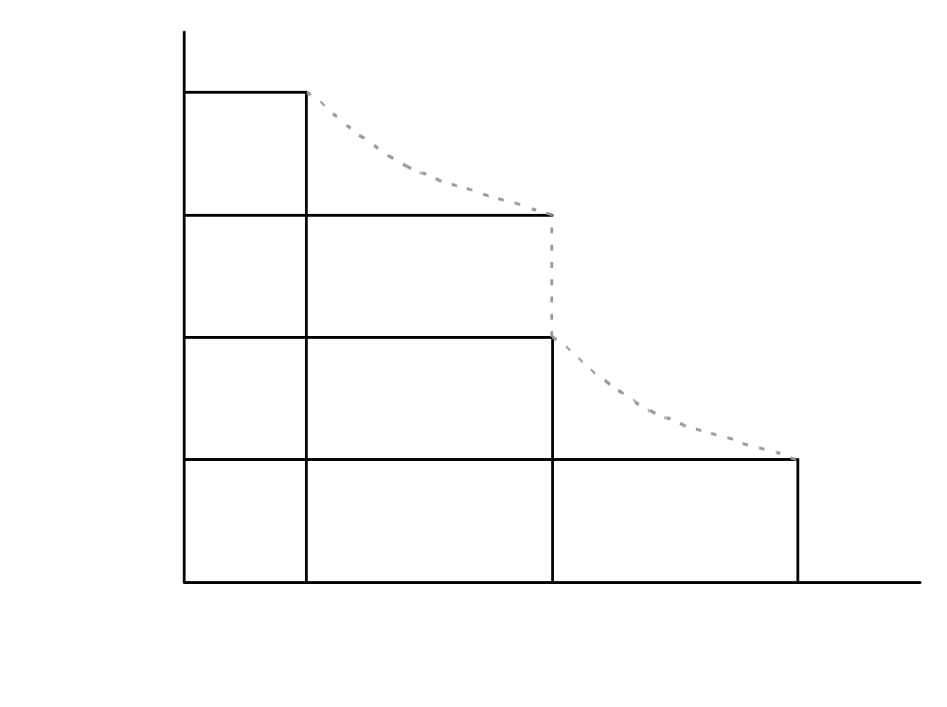
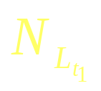
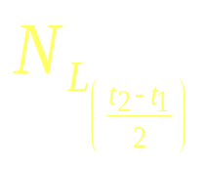
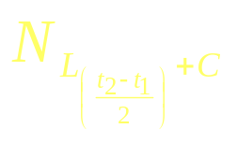
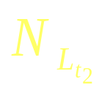

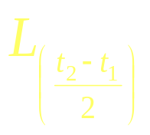
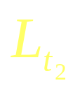
Cohort Analysis (Length-based)
Natural Mortality
Catch
Natural Mortality

Slide 27
Age-based Retrospective Model: predicts past cohort abundance and fishing mortality based on catch and an assumed natural mortality.
Consider a pond stocked with fish that have a life span of 5 years, and that you harvest only 1 fish in the 5th year. You estimate you harvested 37% of those available and that an equal number died to natural causes.
Therefore, the number of fish available at the start of the 5th year is estimated to be 3.

Slide 28
Age-based Retrospective Model (continued)
Reviewing your harvest records, you note that during the previous year, you harvested 3 age 4 fish.
Assuming a natural mortality rate of 50% annually (M = 0.7), and that the harvest was taken half-way through the year, you estimate the number of fish available at the start of the year to be 10.
Finally, using the abundance estimates for age 5 (3) and age 4 (10), and that natural mortality is 50% annually (M = 0.7), then your estimated fishing mortality (F) is 0.6.

Slide 29
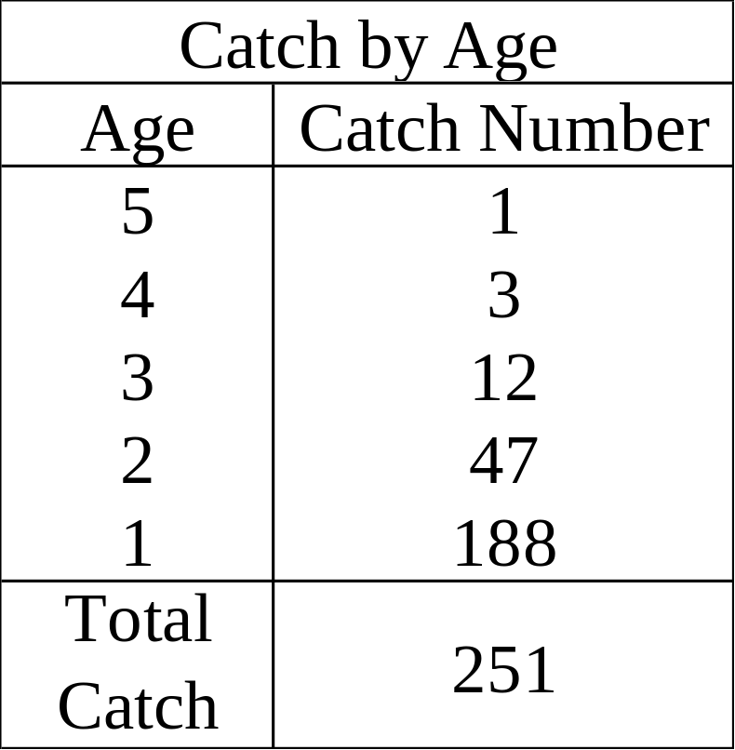
Inputs to an Age-based Retrospective Analysis for a Single Cohort
Natural Mortality
M = 0.7
Terminal Fishing Mortality
F = 0.7
t_{c} = 1 year

Slide 30
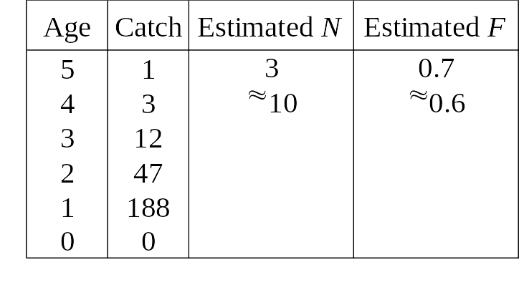
Outputs from an Age-based Retrospective Analysis for a Single Cohort

Slide 31
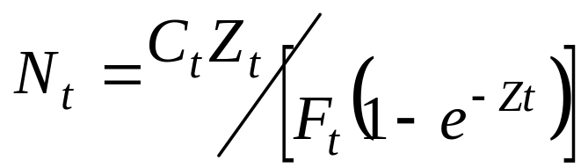
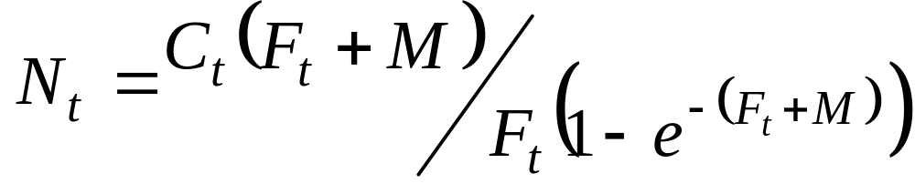
V.P.A. Equations
Rearranged catch equation to estimate abundance at each age:

Slide 32
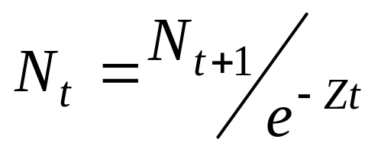
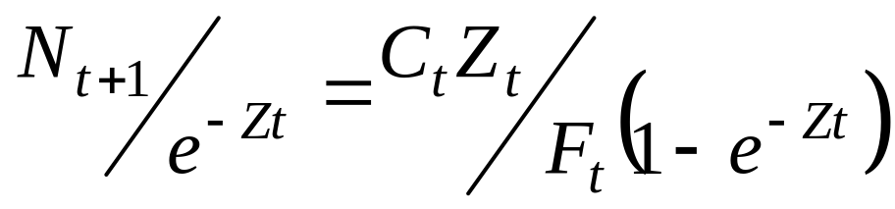
V.P.A. Equations (continued)
Exponential decay equation substituted into rearranged catch equation:

Slide 33
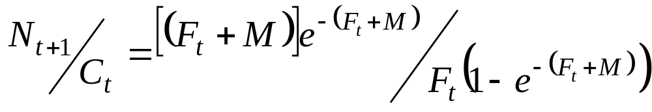
V.P.A. Equations (continued)
Rearranged with F_{t}s on one side of equation and solved iteratively for fishing mortality at each age:

Slide 34
A.C.A. Equations
Rearranged catch equations to estimate abundance at oldest age:

Slide 35
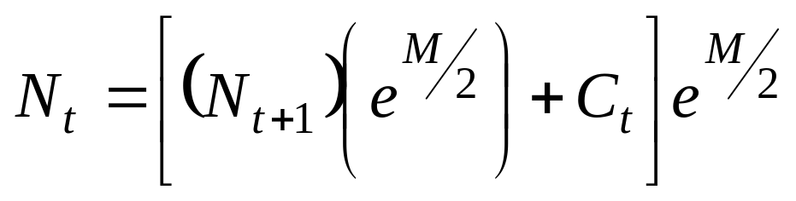
A.C.A. Equations (continued)
Abundance at younger ages (N_{t}) is estimated:

Slide 36
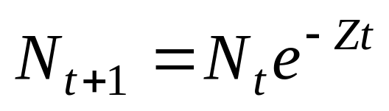
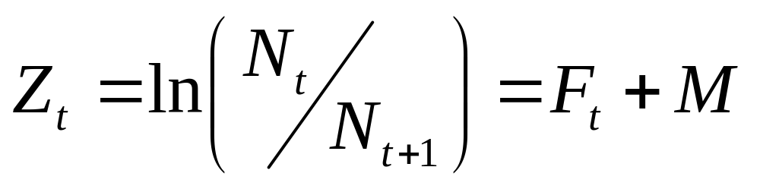
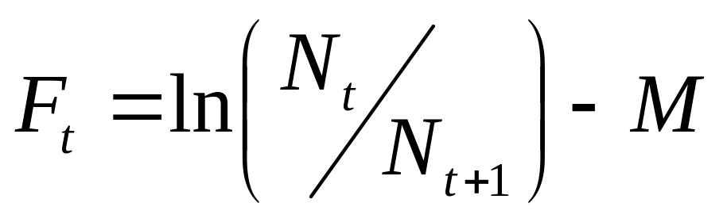
A.C.A. Equations (continued)
Fishing mortality at the t^{th} age is estimated from:

Slide 37
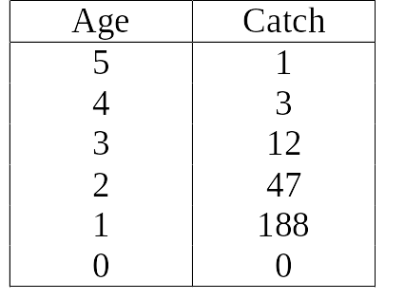
Example: Age-Based Retrospective Model
Data: Given the following catch data by age for the pond fish.
Total Catch: 251 fish over the life span of the cohort

Slide 38
Example: Age-Based Retrospective Model (continued)
    Question: Given the age-based catch history for this cohort (year class), ages (0-5), and an assumed natural mortality of 0.7 based on maximum age of an individual in the cohort and life history characteristics of the species, estimate how many fish were initially recruited to the cohort, the cohort abundance trajectory over the life span and the level of fishing mortality each year.

Slide 39
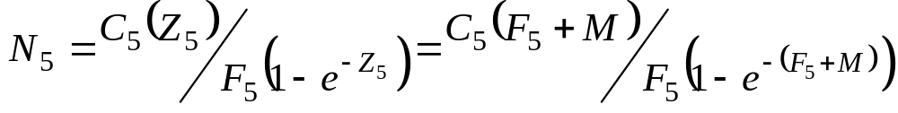
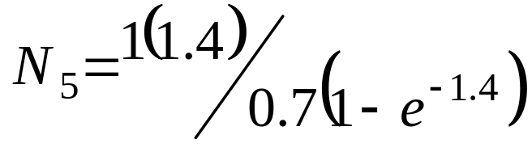
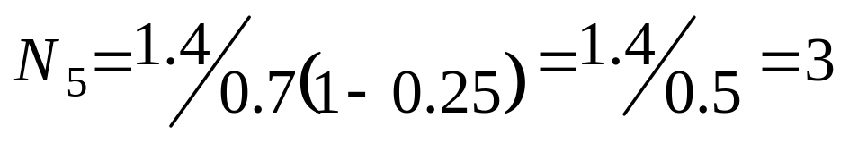
Example: Solution using V.P.A.
Step (1) Using the catch at age 5, the assumed natural mortality rate (M) of 0.7, and an assumed fishing mortality (F) at age 5 of 0.7, a rearranged Baranov catch equation is used to solve for abundance of fish at age 4.

Slide 40
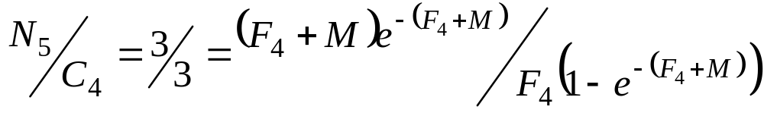
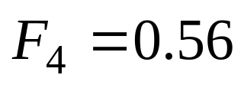
Example: Solution using V.P.A. (continued)
  Step (2) The fishing mortality rate at age 4 fish is estimated by iteratively solving the combined exponential decay and catch equation.
  where M = 0.7, and iteratively solving for F₄

Slide 41
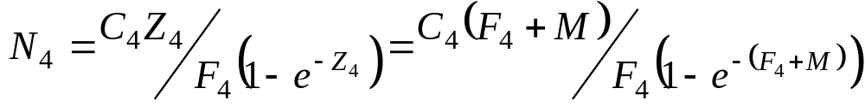
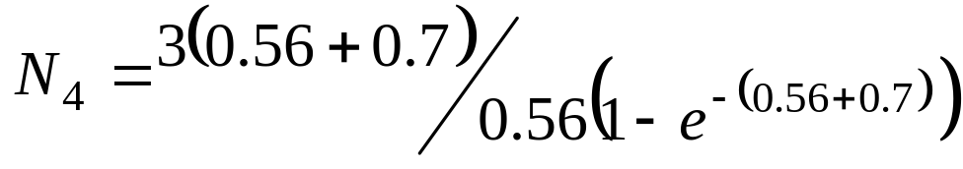
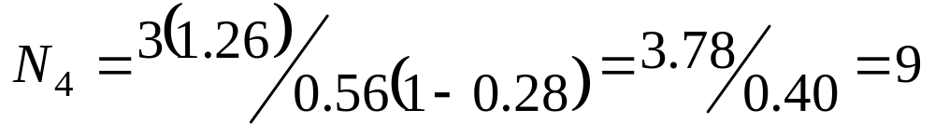
Example: Solution using V.P.A. (continued)
  Step (3) The abundance of age 4 fish is next estimated using the rearranged catch equation.

Slide 42
Example: Solution using V.P.A. (continued)
  Step (4) The fishing mortality rate at age 3 fish is estimated as in Step (2).
Step (5) The abundance of age 3 fish is estimated as in Step (3).
and so on.

Slide 43
Example Solution using V.P.A. (continued)
Results:
Age | Catch | Estimated N | Actual N | Estimated F | Actual F
0 | 0 | 1049 | 1000 | 0.00 | 0.00
1 | 188 | 521 | 491 | 0.66 | 0.70
2 | 47 | 134 | 122 | 0.64 | 0.70
3 | 12 | 35 | 30 | 0.62 | 0.70
4 | 3 | 9 | 7 | 0.56 | 0.70
5 | 1 | 3 | 2 | 0.70 | 0.70

Slide 44
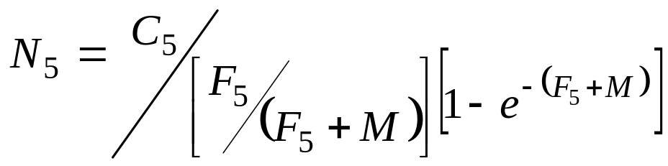
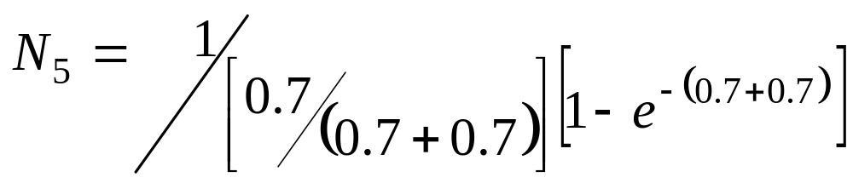
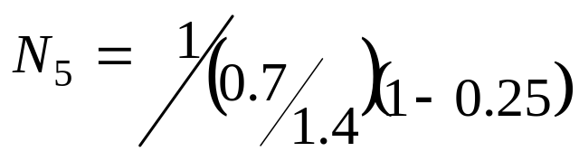

Example Solution using A.C.A.
Step (1) Using the catch at age 5, the assumed natural mortality rate (M) of 0.7, and an assumed fishing mortality rate (F) at age 5 of 0.7, a rearranged Baranov catch equation is used to estimate the abundance of fish at age 5.

Slide 45



Example Solution using A.C.A. (continued)
Step (2) The abundance of age 4 fish is then estimated for using Pope’s cohort analysis method, and the abundance at age 5 (estimated above in Step 1), catch at age 4, and the assumed natural mortality.

Slide 46


Example Solution using A.C.A. (continued)
Step (3) Fishing mortality of age 4 fish is estimated by comparing the abundance of age 5 fish to age 4 fish, allowing for natural mortality.

Slide 47
Example Solution using A.C.A. (continued)
Step (4) Abundance of age 3 fish is estimated as in Step (2).
Step (5) Fishing mortality of age 3 is estimated as in Step (3).
and so on.

Slide 48
Example Solution using A.C.A. (continued)
Results:
Age | Catch | Estimated N | Actual N | Estimated F | Actual F
5 | 1 | 3 | 2 | 0.70 | 0.70
4 | 3 | 10 | 8 | 0.59 | 0.70
3 | 12 | 36 | 31 | 0.63 | 0.70
2 | 47 | 140 | 125 | 0.65 | 0.70
1 | 188 | 549 | 500 | 0.67 | 0.70
0 | 0 | 1105 | 1000 | 0.00 | 0.00

Slide 49
Retrospective Model Input:
Stock Catch-at-Age Matrix
Harvest Year | Catch at Age |  |  |  |  | Total Catch
 | 1 | 2 | 3 | 4 | 5
1990 | C_{1,90,89} | C_{2,90,88} | C_{3,90,87} | C_{4,90,86} | C_{5,90,85} | TC₉₀
1991 | C_{1,91,90} | C_{2,91,89} | C_{3,91,88} | C_{4,91,87} | C_{5,91,86} | TC₉₁
1992 | C_{1,92,91} | C_{2,92,90} | C_{3,92,89} | C_{4,920,88} | C_{5,92,87} | TC₉₂
1993 | C_{1,93,92} | C_{2,93,91} | C_{3,93,90} | C_{4,93,89} | C_{5,93,88} | TC₉₃
1994 | C_{1,94,93} | C_{2,94,92} | C_{3,94,91} | C_{4,94,90} | C_{5,94,89} | TC₉₄
1995 | C_{1,95,94} | C_{2,95,93} | C_{3,95,92} | C_{4,95,91} | C_{5,95,90} | TC₉₅
1996 | C_{1,96,95} | C_{2,96,94} | C_{3,96,93} | C_{4,96,92} | C_{5,96,91} | TC₉₆

Slide 50

Retrospective Model Output:
Stock Abundance-at-Age Matrix

Slide 51
Retrospective Model Output:
Stock Fishing Mortality-at-Age Matrix
Harvest Year | Fishing Mortality at Age |  |  |  |  | Average Fishing Mortality
 | 1 | 2 | 3 | 4 | 5
1990 | F_{1,90,89} | F_{2,90,88} | F_{3,90,87} | F_{4,90,86} | F_{5,90,85} | AF₉₀
1991 | F_{1,91,90} | F_{2,91,89} | F_{3,91,88} | F_{4,91,87} | F_{5,91,86} | AF₉₁
1992 | F_{1,92,91} | F_{2,92,90} | F_{3,92,89} | F_{4,92,88} | F_{5,92,87} | AF₉₂
1993 | F_{1,93,92} | F_{2,93,91} | F_{3,93,90} | F_{4,93,89} | F_{5,93,88} | AF₉₃
1994 | F_{1,94,93} | F_{2,94,92} | F_{3,94,91} | F_{4,94,90} | F_{5,94,89} | AF₉₄
1995 | F_{1,95,94} | F_{2,95,93} | F_{3,95,92} | F_{4,95,91} | F_{5,95,90} | AF₉₅
1996 | F_{1,96,95} | F_{2,96,94} | F_{3,96,93} | F_{4,96,92} | F_{5,96,91} | AF₉₆

Slide 52
Length-based Retrospective Model: predicts fishing mortality and stock abundance based on catch at length during a given year (creating a “pseudo-cohort”), and an assumed natural mortality and equal annual recruitment to the stock.
Consider a pond stock annually with equal but unknown numbers of fish that have a life span of 5 years, and that have a known growth curve, reaching a maximum size of 40 cm.
Therefore, the frequency distribution of fish by length in the pond in a given year reflects the frequency distribution of a given cohort with age or length.

Slide 53
Length-based Retrospective Model (continued)
In a given year, you harvest 53 fish in the size range of 35-39 cm, 88 fish in the 30-34 cm range, and 110 fish in the 25-29 cm range.
Assuming a typical terminal exploitation ratio (F/Z) at 50%, then you estimate that 108 fish of the 35-39 size range at the onset of the period.
Similarly, if there were 88 fish caught in the 30-34 cm size range, then the cohort size at the beginning of the period is estimated at 287.
Finally, fishing mortality between the length classes is estimated at 0.7.

Slide 54

Inputs to a Length-based Retrospective Analysis for a Pseudo Cohort
Natural Mortality
M = 0.7
Terminal Fishing Mortality
F = 0.7
L_{c} = 25 cm

Slide 55

Outputs from a Length-based
Retrospective Analysis for a Pseudo Cohort

Slide 56

L.C.A. Equations
Abundance within each length interval of the pseudo-cohort is estimated by:

Slide 57

L.C.A. Equations (continued)
Where Δt is the time required to grow from the beginning to the end of a length interval, and Δt is estimated from the rearranged von Bertalanffy growth equation.

Slide 58

Example Solution using L.C.A.
Data: Given the following catch data by length for the pond fish.
Total catch: 251 fish over the size range of the cohort

Slide 59
Example Solution using L.C.A. (continued)
Question: Given the length-based catch history for this pseudo-cohort, length (0-40 cm), and an assumed natural mortality of 0.7, estimate the cohort abundance by length, and the level of fishing mortality within each size range.

Slide 60

Example Solution using L.C.A. (continued)
The time interval (Δt) for each length class is estimated using the von Bertalanffy growth function for the limits of each length class:
Assume: Natural Mortality, M = 0.7
Length | t₁ | t₂ | Δt
0-4 | 0 | 0.13 | 0.13 | 1.0466
5-9 | 0.13 | 0.29 | 0.16 | 1.0576
10-14 | 0.29 | 0.47 | 1.18 | 1.0650
15-19 | 0.47 | 0.70 | 0.23 | 1.0838
20-24 | 0.7 | 0.98 | 0.28 | 1.1030
25-29 | 0.98 | 1.39 | 0.41 | 1.1543
30-34 | 1.39 | 2.08 | 0.69 | 1.2732
35-39 | 2.08 | 6.00 | 3.92 | 3.9432

Slide 61


Example Solution using L.C.A. (continued)
    Step (1) The abundance of fish starting the largest length class is estimated using a modified, rearranged Baranov catch equation, and using the catch of the largest length class, the assumed natural mortality (M), and an assumed exploitation ratio (F/Z) for the largest length class of 0.5.

Slide 62



Example Solution using L.C.A. (continued)
    Step (2) The abundance of fish starting the second largest length class is estimated using a Jones length-cohort equation (adapted from the Pope age-cohort equation), and the catch for the second largest length class.

Slide 63


Example Solution using L.C.A. (continued)
Step (3) The exploitation ratio for the second largest length class is estimated by comparing the abundance of fish starting the largest and second largest length classes, and allowing for catch.

Slide 64


Example Solution using L.C.A. (continued)
  Step (4) Fishing mortality for the second largest length class is estimated from the exploitation ratio and the assumed natural mortality.

Slide 65
Example Solution using L.C.A. (continued)
Step (5) Abundance of the third largest length class is estimated as in Step (2).
Step (6) Exploitation ratio is estimated as in Step (3).
Step (7) Fishing mortality is estimated as in Step (4).
and so on.

Slide 66
Example Solution using L.C.A. (continued)
Length | Catch | Estimated N | Actual N | Estimated F | Actual F
35-39 | 53 | 106 | 108 | 0.70 | 0.70
30-34 | 88 | 284 | 284 | 0.69 | 0.70
25-29 | 110 | 505 | 506 | 0.69 | 0.70
20-24 |  | 616 | 613 | 0.00 | 0.00
15-19 |  | 722 | 720 | 0.00 | 0.00
10-14 |  | 819 | 816 | 0.00 | 0.00
5-9 |  | 916 | 913 | 0.00 | 0.00
0-4 |  | 1003 | 1000 | 0.00 | 0.00

Slide 67
Retrospective Model Input:
Stock Catch-at-Length Matrix
Harvest Year | Catch at Length |  |  |  | Total Catch
 | 25-29 | 30-34 | 35-39 | 40-44
1990 | C_{25-29,90} | C_{30-34,90} | C_{35-39,90} | C_{40-44,90} | TC₉₀
1991 | C_{25-29,91} | C_{30-34,91} | C_{35-39,91} | C_{40-44,91} | TC₉₁
1992 | C_{25-29,92} | C_{30-34,92} | C_{35-39,92} | C_{40-44,92} | TC₉₂
1993 | C_{25-29,93} | C_{30-34,93} | C_{35-39,93} | C_{40-44,93} | TC₉₃
1994 | C_{25-29,94} | C_{30-34,94} | C_{35-39,94} | C_{40-44,94} | TC₉₄
1995 | C_{25-29,95} | C_{30-34,95} | C_{35-39,95} | C_{40-44,95} | TC₉₅
1996 | C_{25-29,96} | C_{30-34,96} | C_{35-39,96} | C_{40-44,96} | TC₉₆

Slide 68

Retrospective Model Output:
Stock Abundance-at-Length Matrix

Slide 69
Retrospective Model Output:
Stock Fishing Mortality-at-Length Matrix
Harvest Year |  |  |  |  | Average Fishing Mortality
 | 25-29 | 30-34 | 35-39 | 40-44
1990 | F_{25-29,90} | F_{30-34,90} | F_{35-39,90} | F_{40-44,90} | AF₉₀
1991 | F_{25-29,91} | F_{30-34,91} | F_{35-39,91} | F_{40-44,91} | AF₉₁
1992 | F_{25-29,92} | F_{30-34,92} | F_{35-39,92} | F_{40-44,92} | AF₉₂
1993 | F_{25-29,93} | F_{30-34,93} | F_{35-39,93} | F_{40-44,93} | AF₉₃
1994 | F_{25-29,94} | F_{30-34,94} | F_{35-39,94} | F_{40-44,94} | AF₉₄
1995 | F_{25-29,95} | F_{30-34,95} | F_{35-39,95} | F_{40-44,95} | AF₉₅
1996 | F_{25-29,96} | F_{30-34,96} | F_{35-39,96} | F_{40-44,96} | AF₉₆

Slide 70
Applications and Limitations of Age-based and Length-based Cohort Analysis
Bluefish (Lazar 1998)
American Lobster (Cadrin and Estrella 1996)

Slide 71

Bluefish Input: Catch at Age Matrix

Slide 72

Bluefish Input:
Population Abundance Matrix

Slide 73

Bluefish Output:
Stock Abundance by Age Plot

Slide 74

Bluefish Output:
Fishing Mortality at Age Matrix

Slide 75

Bluefish Model Output: Sensitivity of Estimated Population Structure in 1995 to the Assumed Natural Mortality Value
M Total N

Slide 76

Bluefish Model Output: Sensitivity of Estimated Population Structure in 1995 to the Selection of Terminal F Values

Slide 77

American Lobster Input:
Catch at Length Matrix for 1993 (Georges Bank)

Slide 78

American Lobster Output:
Population Abundance Matrix 1993 (Georges Bank)

Slide 79

American Lobster Output:
Fishing Mortality Matrix for 1993 (Georges Bank)

Slide 80

American Lobster Output:
Sensitivity of Weighted Average F to the Assumed Natural Mortality

Slide 81

American Lobster Output:
Sensitivity of Weighted Average F to the Assumed F on the Largest Size Class

Slide 82

American Lobster: Summary of Catch, Abundance, and Fishing Mortality for
Gulf of Maine Females (1981-1993)

Slide 83
Summary and Conclusion
Sequential population analyses are data and computer intensive methods that provide estimates of population abundance and fishing mortality rates.
Age-based cohort analysis is sensitive to the selection of assumed natural mortality and terminal fishing mortality.
Length-based cohort analysis based on catch numbers from a “pseudo-cohort” in a given year assumes equal annual recruitment, and is also sensitive to the selection of an assumed natural mortality, but insensitive to the assumed F of the largest length class.

